Slide 1
Homelessness in Our Communities
Western Massachusetts
Integrated Treatment Services
Trauma-Responsive Homelessness Work
Collaborative Mental Health, Substance Abuse, Medical, and Housing Case Management Programming in Western Massachusetts
Christy O’Brien, MSW, LICSW

Slide 2
Christy O’Brien, LICSW
Center for Human Development, Program Director, Community Behavioral Health Center (CBHC), Chicopee
Friends of the Homeless, Clinical Director; Model and Services

Slide 3
Homelessness In Massachusetts
U.S. Department of Housing and Urban Development (HUD) Data:
  2020 = 17,975
  2023 = 23,000
  2007-2023 = 88.5% increase
Record-breaking influx of migrant/refugee families.
Homeless Youth:
  25% identified as LGBTQ+
  31% were involved in the foster care system.
Veterans
  2019 = 534

Slide 4
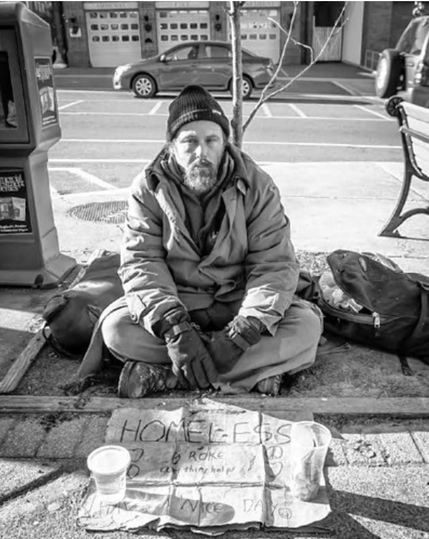
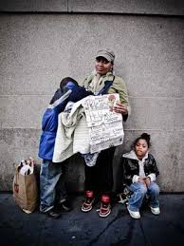
Two Categories:
Individual & Family Shelter Systems

Slide 5
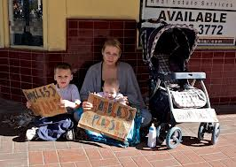
Massachusetts:
Family Right to Shelter State

Slide 6
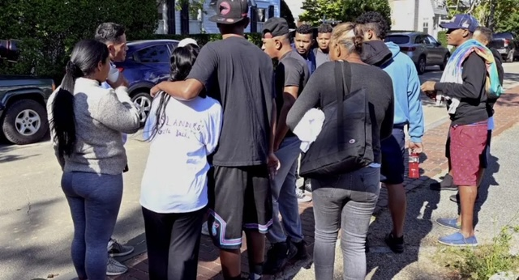
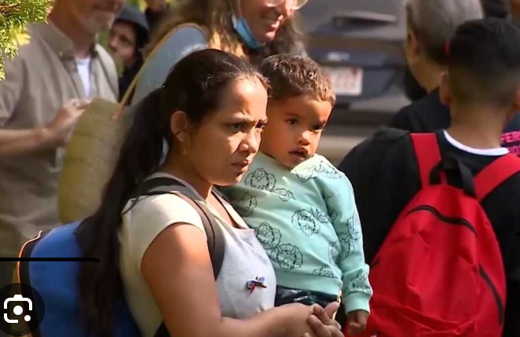

Shelter Crisis
August 2023: Gov. Healy identified funding cap at 7,500 families/23,000+ individuals
October 30, 2023, 7,319 occupied
November 9, 2023 = 0
  Governor Maura Healey announced that "the state does not have enough shelter, space, service, providers, or funding to safely expand beyond 7500 families."
  Declared state of emergency in August 2023
  3,806 families living in hotels and motels, 3,650 at traditional shelter sites, and 61 in temporary locations.

Slide 7
What do we do?
Point in Time Count
Continuum of Care (CoCs); Chronically Homeless List
Hierarchy of housed first
  Elderly
  Medically Ill
  Severely Mentally Ill
  Veterans
  Youth
Expedite transitional-to-permanent housing
Push systems:
  DMH, DDS, DCF

Slide 8
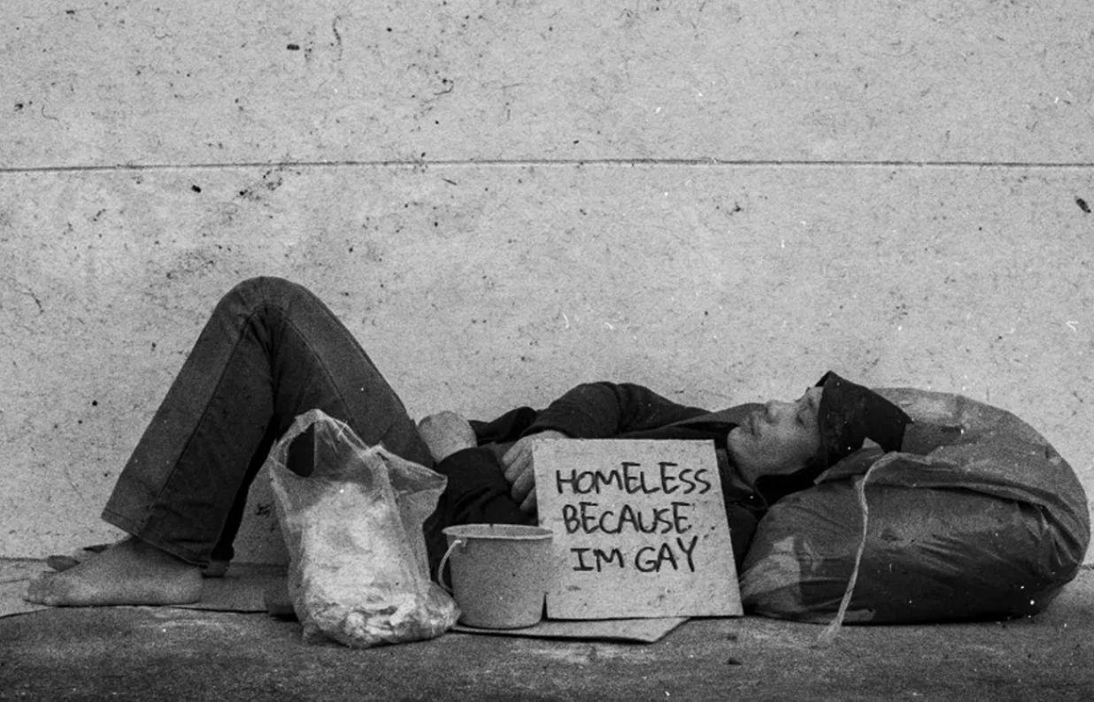
Discrimination of the Unsheltered
Anti-homeless ordinances.
Anecdote experiences of discrimination. In a 2014 survey, the National Coalition for the Homeless reported at 70.4% of homeless respondents felt that they had been discriminated against.
LGBTQ+ youth both report being turned away from shelters.
Reported experiences of homophobia and transphobia while in shelters.
Providing civil rights protections to people experiencing homelessness will reduce the barriers they face trying to exit homelessness for good.

Slide 9

Known Population Details: FOH, 2018

Slide 11
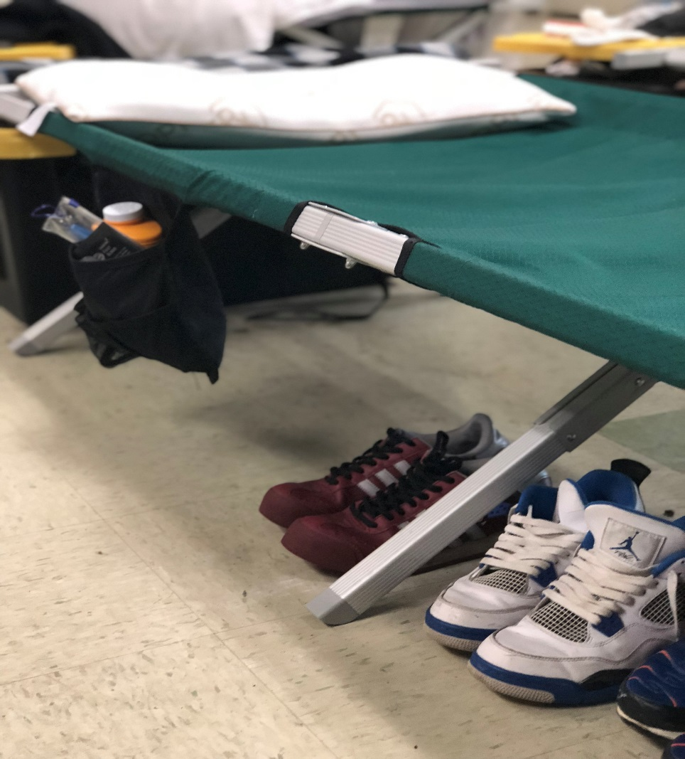


Trauma, Substance Abuse, and Homelessness

Slide 12

Theoretical Assumptions:
Housing First, Best Practice
  Immediate access to permanent housing
  Choice and self-determination
  Recovery Support
  Individualized support services
  Community integration
= “Housing stability has been shown to support long-term recovery and prevent relapse from substance abuse and mental disorders (Kertesz, Horton, Friedmann, Saitz, & Samet, 2003, in SAMHSA 2015).

Slide 13
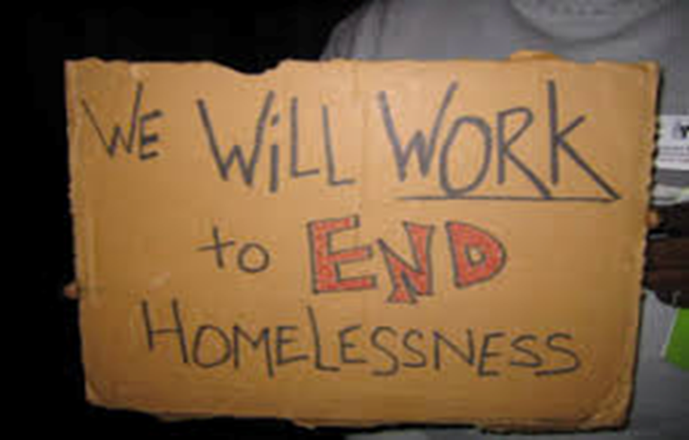
Trauma-Responsive Homelessness Intervention
Principles of Trauma Informed Care (TIC) (Fallot & Harris, 2009; Hopper et al., 2010; Olivet et al., 2010 in Levy & Johnson, 2018):
  Safety
  Trustworthiness and transparency
  Peer Support
  Collaboration
  Empowerment
  Voice and choice
TIC in homelessness: (Levy & Johnson, 2018)
  An awareness of the nature and later expression of past trauma;
  An emphasis on safety;
  Creating opportunities to rebuild control; and,
  Adoption of strengths-based approach.

Slide 14
Western MA “Emergency” Shelters
Friends of the Homeless, Springfield
Grove Street Inn (CSO), Northampton
Springfield Rescue Mission, Springfield, Mill St. & Taylor St.
Samaritan Inn, Westfield
Greenfield Shelter (CSO)
Barton’s Crossing, Pittsfield, (ServiceNet)
Providence Ministries, Holyoke = Pop-Up
Amherst Shelter, Craig’s Doors, (behavior based)

Slide 15
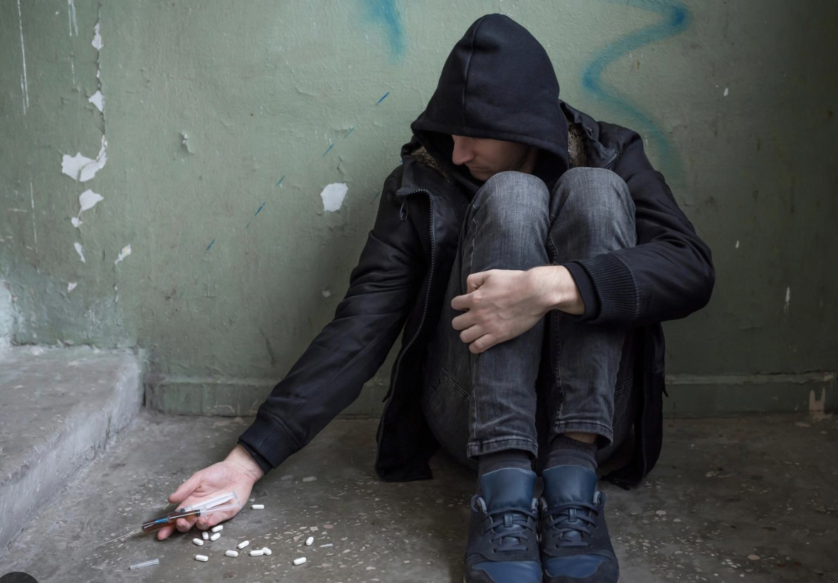
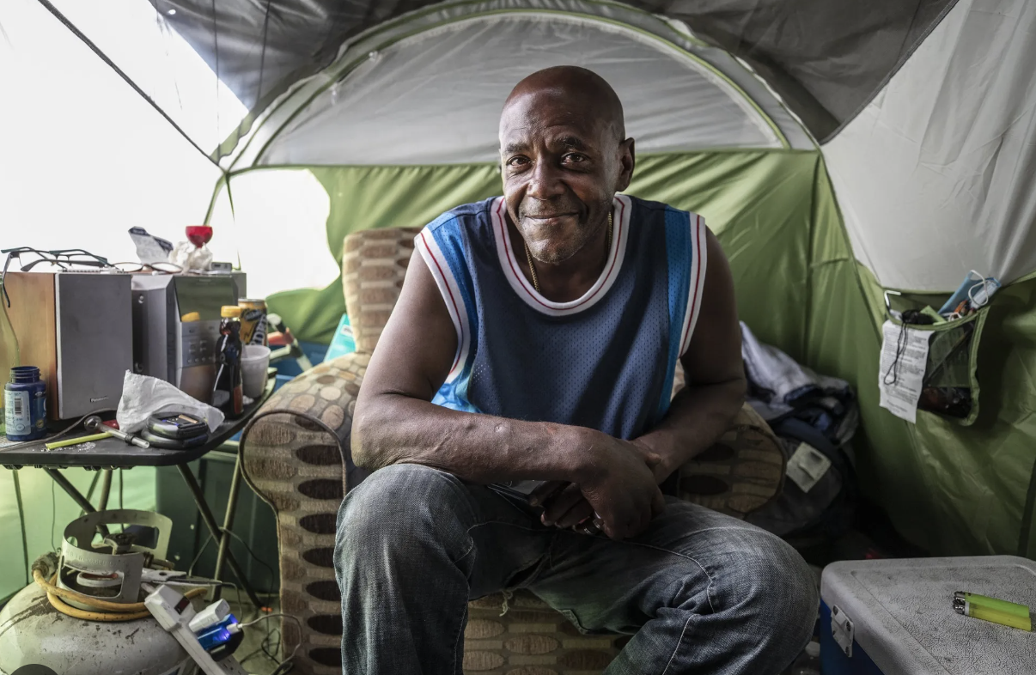
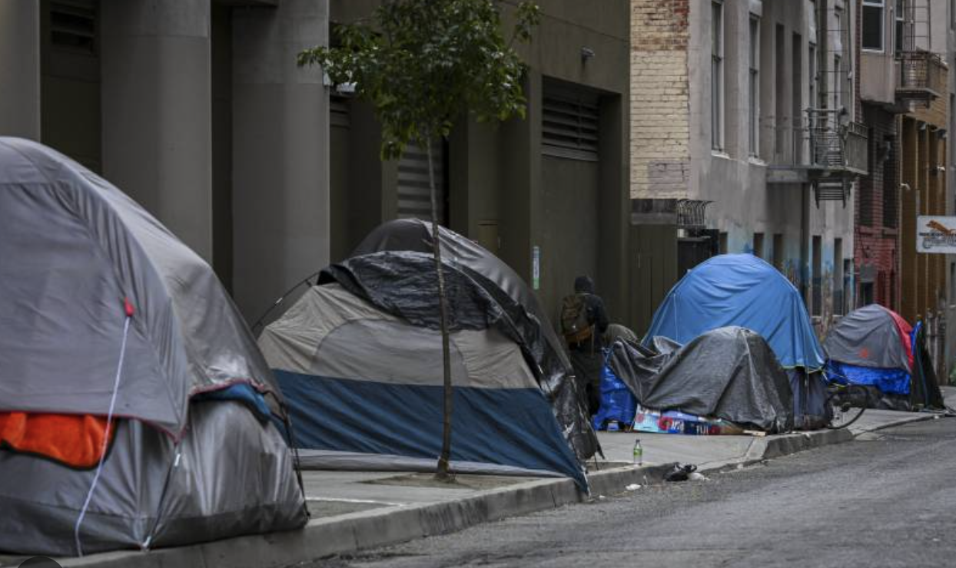
Shelter Refusal
Why would anyone refuse shelter?
  Trauma, PTSD
  Substance Use and lack of Harm-Reduction
  Autonomy & Respect

Slide 16
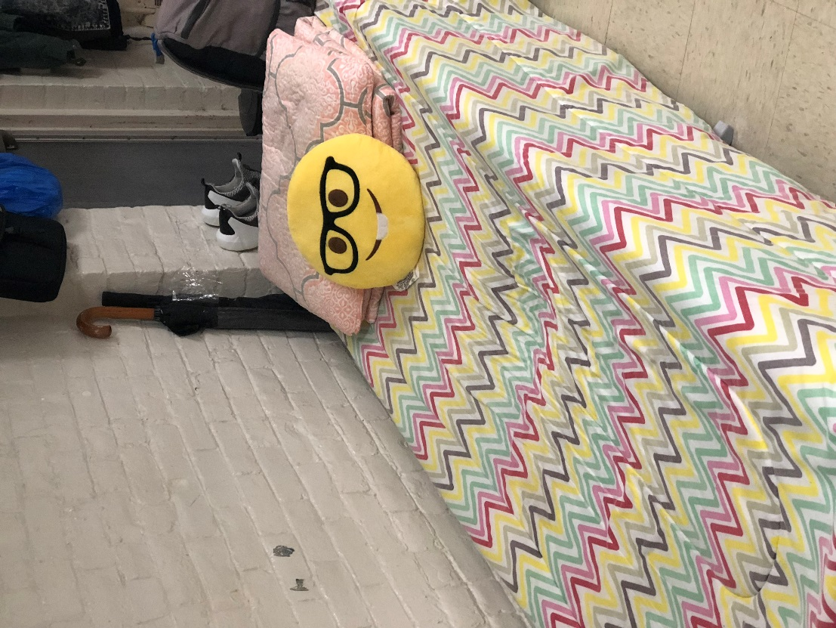
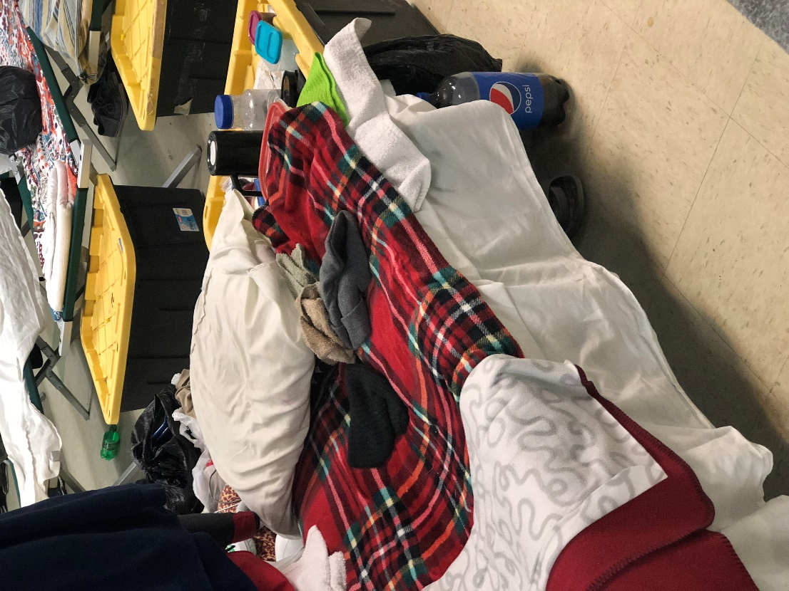
Emergency Shelter:
“Describe your first night in shelter?”

Slide 17
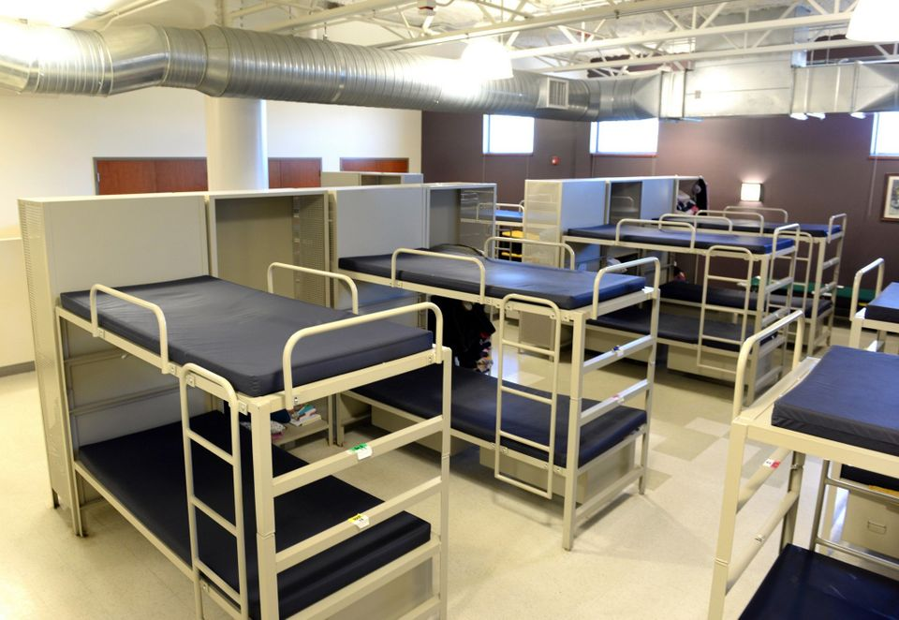
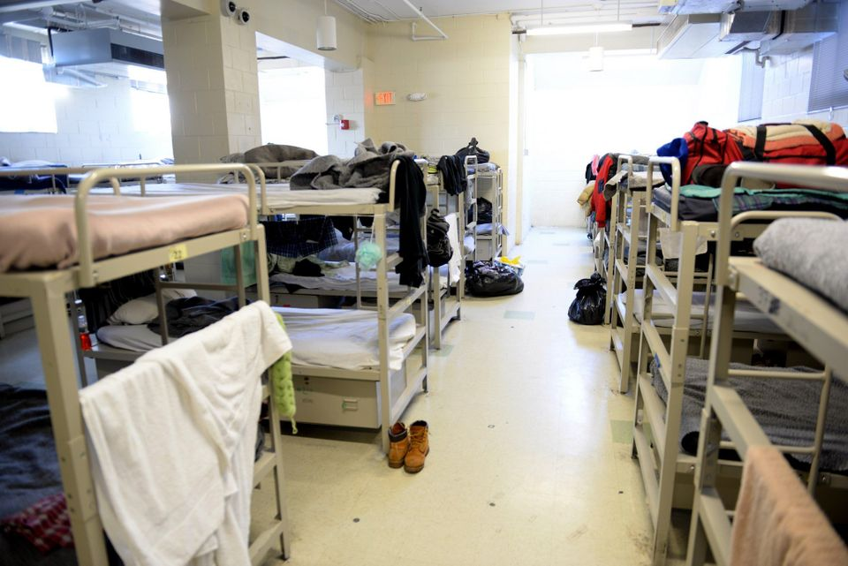

Slide 18
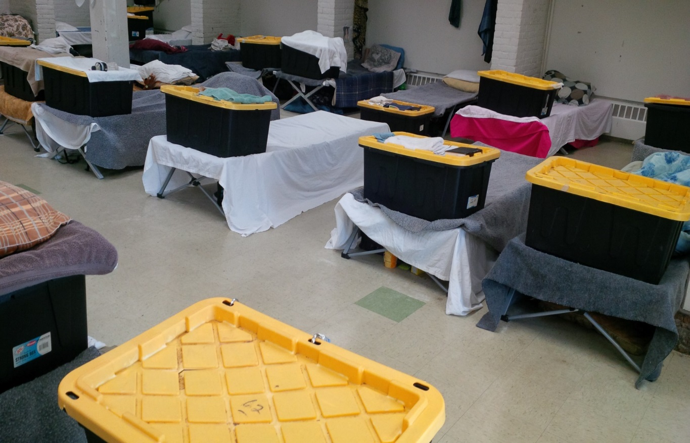
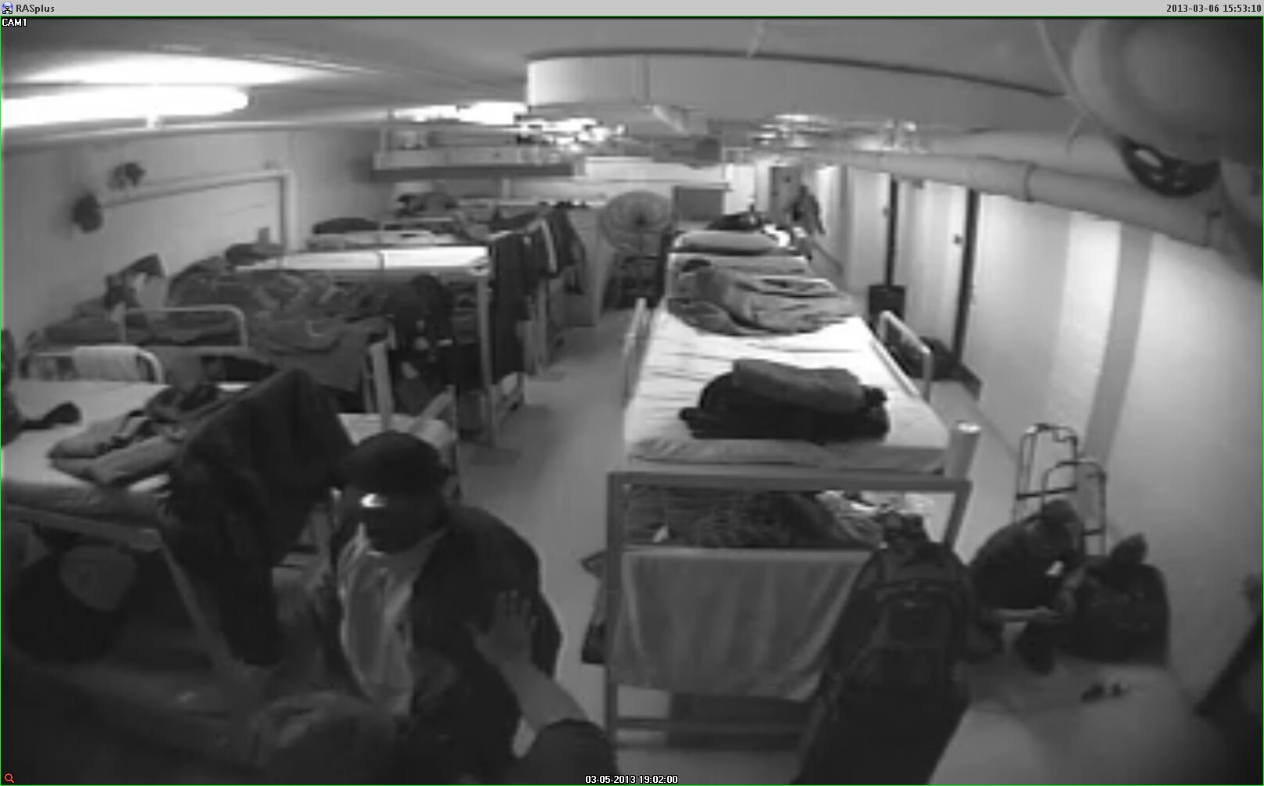
Beds, cots, and floors.
Overstimulation, no privacy, in a community of traumatized and trauma. Listen in!

Slide 19

Common Mental Health Challenges:
Trauma: Post-traumatic Stress Disorder, Acute Stress Disorder, Trauma of Chronic Poverty, Trauma of System Failures, Attachment Traumas, Trauma of Homelessness.
Mood Disorders: Depression, Bipolar Disorders
Anxiety Disorders: Generalized Anxiety Disorder
Psychotic Disorders: Schizoaffective Disorder, Schizophrenia
Substance Use Disorders: Opioid Use, Alcohol Use, Cocaine Use, Cannabis Use

Slide 20
“Triple-Diagnosis” Population:
Mental or behavioral health challenges
+
Substance use challenges
+
Medical challenges

Slide 21
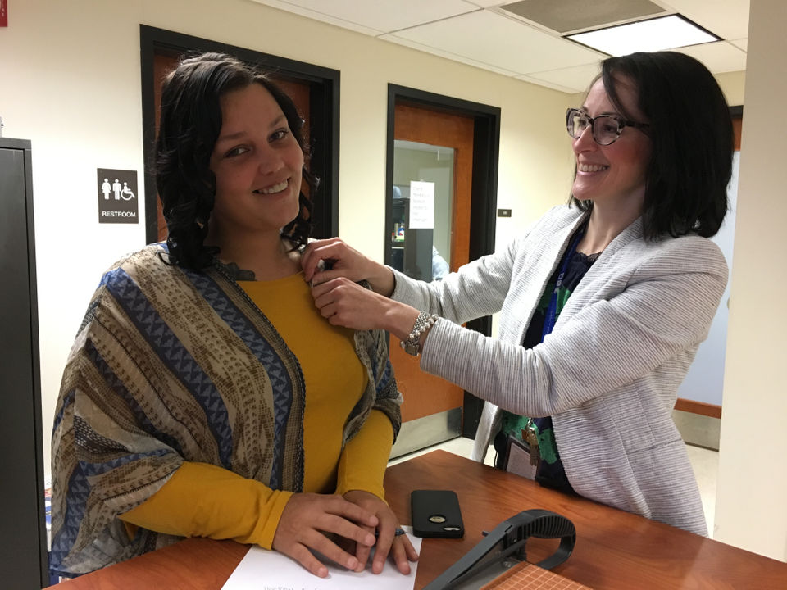
Integrated Treatment Services
Agencies, such as, Substance Abuse and Mental Health Services Administration (SAMHSA), delegate millions of federal dollars to non-profits for the integration of:
mental health
substance abuse
medical care, and
rapid housing search services for those experiencing homelessness.

Slide 22
Successful Path To Housing
The Team:
The Outcomes:
Case Manager
Housing Placement Specialists/Housing Navigator (CHD, FOH, Elliot Services)
Outreach Team
  Community Support Providers
  Recovery Support Navigators
Mental Health
SUD Tx Centers
Affiliate PCPs/Health Care for the Homeless
Case Managment
County chronically homelessness list.
Section 8, Food Stamps, etc.
Connection to Mental Health Support
Connection to SUD Tx, Recovery Coaching
Medical Care
Transportation
DCF, Probation, Court
Enduring supports

Slide 23

Important
Engagement Philosophies
Harm reduction:
  “Inherent in harm reduction is an understanding that it is not necessarily the drugs themselves that do the most damage to a user; the laws and systems of prohibition – which make drug procurement and possession illegal – are what hurt people the most” (Lupik,2017)
  Self-determination:
  “Allowing each person to determine for themselves the time, place, course, and method of therapeutic treatment chosen, if any” (Lupik, 2017).

Slide 24

Supporting Those With Substance Use
Bearing witness
Engagement, relationship
Providing acceptance
Self-determination and Autonomy:
  “Allowing each person to determine for themselves the time, place, course, and method of therapeutic treatment chosen, if any” (Lupik, 2017)
Building relationships with area providers
    Crisis Teams
    Harm reduction supports
    Inpatient detox

Slide 25
Center for Human Development’s Behavioral Health Center (CBHC)
Laying the Groundwork for
Improved Community-Based Acute Care
C

Slide 26
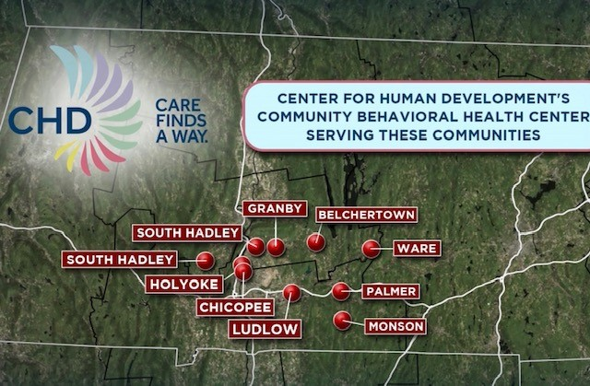
C

Slide 27

CBHCs: The Basics
Mass. EOHHS has designated providers across the state as Community Behavioral Health Centers.
  Catchments
  Broadened Acute Care Services
  Keeping More in the Community
  Reduced ED boarding

Slide 28

Spectrum of Acuity
Treatment throughout the CBHC, larger CHD, and community partner continuum
Substance Use Services and MAT
Police Co-Response
Outpatient Therapy and Psychiatry
Urgent Outpatient
Crisis Intervention
Crisis Stabilization
Inpatient
School Interventions
Hospital ED Support
C

Slide 29
Spectrum of Acuity
Treatment throughout the CBHC, larger CHD, and community partner continuum
“I am struggling with substance use and need help.”
“I have had police interaction and they are helping me get immediate support.”
“I am stable and in insight-based therapy and psychiatry”
“I don’t feel great and I need help faster than my next OP appointment.”
“I need immediate help.”
“I need to be in a supportive, structured, 24-hour community setting.”
“I need to be in a supportive, structured, locked hospital setting.”
“I have had school staff intervention and they are helping me get immediate support.”
“I am getting checked out or admitted for life-threatening medical or psychiatric needs.”
C

Slide 30
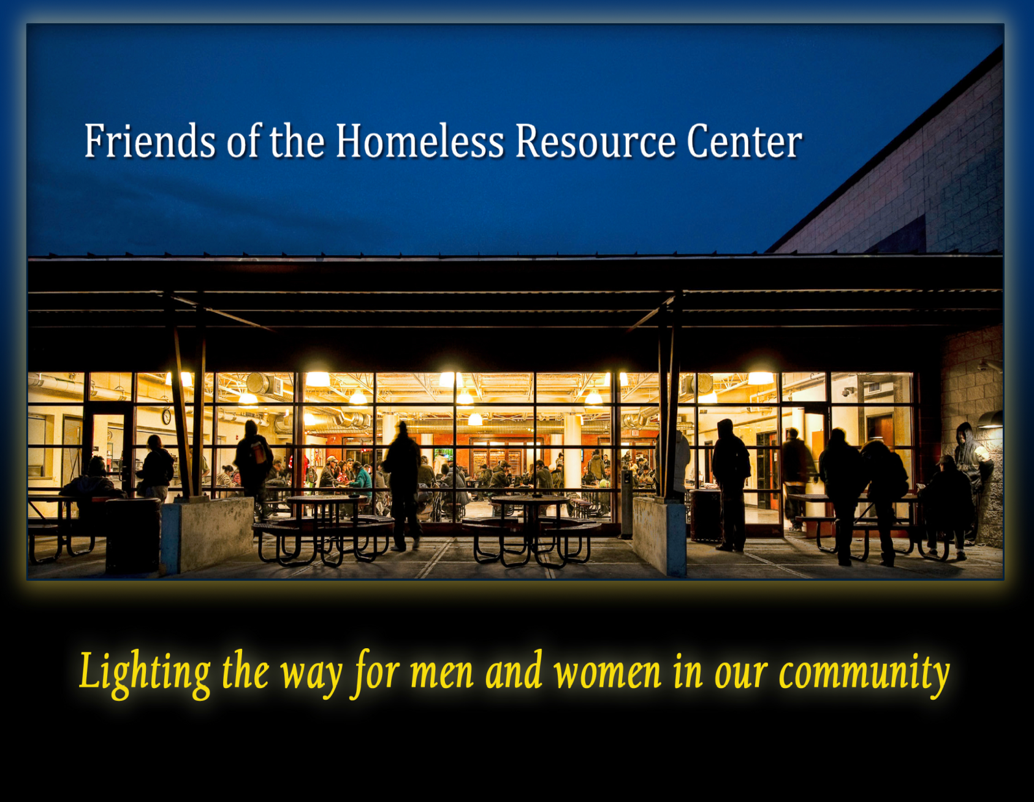
Trauma, Substance Abuse, Homelessness Work – What Keeps the Helpers Going?

Slide 31

Helping the Helpers
Knowing your resources
Boundary setting, managing expectations
Vicarious Trauma Trainings
Formalized debriefing
Narcan training
Mental Health

Slide 32

Brainstorm
Self-Assessment:
Where are points of integration in your work?
Where is the integration, developmentally?
Levels of acceptance to change in community?
Where are there obstacles, and what are they?
What do the successes look like?

Slide 33
This Work is Hard.

